Slide 1

SC1007 Data Structure and Algorithms Tutorial Session 1 Linked Lists

Slide 2
Introduction
Introduction
Marcus Vinícius de Carvalho
marcus.decarvalho@ntu.edu.sg
Computer Engineer
Research Fellow @ NTU / Research Manager @ A*STAR
Interested in Artificial Intelligence, Computer Graphics and Low-Level Programming
Notes
We will ALWAYS have a slide at the END of the PPT with a QR code to download this PPT (and code snippets)
Therefore, focus on paying attention and participate in the tutorials instead of taking photos of the slides
However, you should take notes if you find it necessary
If the tutorial content is too heavy, I will move the QR code to the BEGIN of the PPT, so you can follow it up on the go and write comments directly on the slide
Do not mark the attendance sheet for other students. Mark it only for yourself.

Slide 3
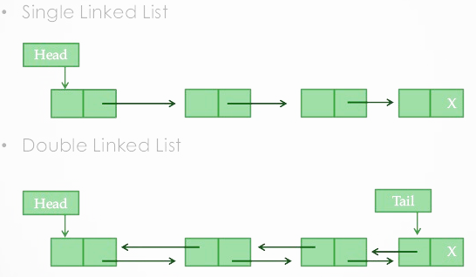
Linked Lists
Usage:
Music Player (Spotify, Apple Music) playlist
Undo-Redo functionality
Browser history (past page / next page)
ArrayList ( common in JavaScript and TypeScript)
and more
Variations:
Single Linked List
Double Linked List
Circular Linked List
Skip Linked List
and more

Slide 4
Question 1

Slide 5
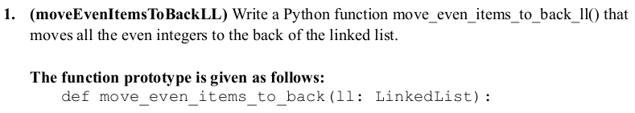
Question 1

Slide 6
Question 1
Input => Output
Example 1: 2, 3, 4, 7, 15, 18 => 3, 7, 15, 2, 4, 18
Example 2: 2, 7, 8, 3, 4, 15 => 7, 3, 15, 2, 18, 4
Example 3: 1, 3, 5 => 1, 3, 5
Example 4: 2, 4, 5 => 2, 4, 6

Slide 7
Question 1
Logic 1:
Size must be at least 2 (otherwise, we can't move links)
There are multiple ways to check it. Can you guess two?
Two pointers
Pointer 1: Track the current item
Pointer 2: Track the current even item

Slide 8
Question 1
Logic 1:
Size must be at least 2 (otherwise, we can't move links)
There are multiple ways to check it. Can you guess two?
1: Check if size is greater than 2
2: Check if there is head and head->next
Two pointers
Pointer 1: Track the current item
Pointer 2: Track the current even item

Slide 9
Question 1
Logic 2:
Size must be at least 2 (otherwise, we can't move links)
There are multiple ways to check it. Can you guess two?
1: Check if size is greater than 2
2: Check if there is head and head->next
Single pointer
Pointer: Track the current item [ i.e. a for loop ]
If even: send to the end of the list

Slide 10
Question 1
def moveEvenItemsToBack(ll): if ll.size < 2: return cur = ll.head index = 0 for _ in range(ll.size): if cur.item % 2 == 0: even_value = cur.item cur = cur.next ll.removeNode(index) ll.insertNode(ll.size, even_value) else: cur = cur.next index += 1

Slide 11
Question 2

Slide 12
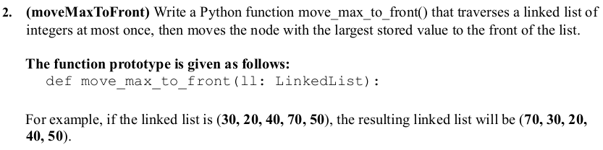
Question 2

Slide 13
Question 2
Input => Output
Example 1: 30, 20, 40, 70, 50 => 70, 30, 20, 40, 50

Slide 14
Question 2
Logic 1:
Size must be at least 2
Track the current node
Track the node with maximum value

Slide 15
Question 2
Logic 1:
Size must be at least 2 (otherwise, we can't move links)
Track the current node [ cur ]
Track the node with maximum value [ max_node ]
Also need to track who points to the max_node [ pre_max ]
Then:
Iterate through the whole list ( loop )
Move pre_max.next to max_node.next
Move max_node.next to head.next
Make max_node the head

Slide 16
Question 2
def moveMaxToFront(ll): if ll.head is None or ll.head.next is None: # Empty list or single node return -1 pre_max = None max_node = ll.head cur = ll.head while cur.next is not None: if cur.next.item > max_node.item: pre_max = cur max_node = cur.next cur = cur.next if pre_max is None: # Max node is already at the front return 0 # Move the max node to the front pre_max.next = max_node.next max_node.next = ll.head ll.head = max_node return 0

Slide 17
Question 3

Slide 18
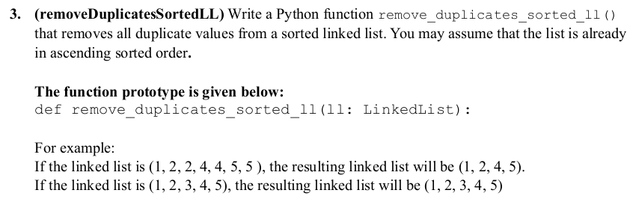
Question 3

Slide 19
Question 3
Input => Output
Example 1: 1, 2, 2, 4, 4, 5, 5 => 1, 2, 4, 5
Example 2: 1, 2, 3, 4, 5, => 1, 2, 3, 4, 5

Slide 20
Question 3
Logic 1:
Size must be at least 2 (otherwise, the probability of having pairs is zero)
Because the list is already ascending, duplicated numbers will be forming a pair, so:
Check if cur.item is equal to cur.next.item
if true: remove one of them
continue the loop

Slide 21
Question 3
def remove_duplicates_sorted_ll(ll):
current = ll.head
if current is None:
return
while current.next is not None:
if current.item == current.next.item:
temp = current.next.next
current.next = temp
ll.size -= 1
else:
current = current.next

Slide 22
Question 4

Slide 23
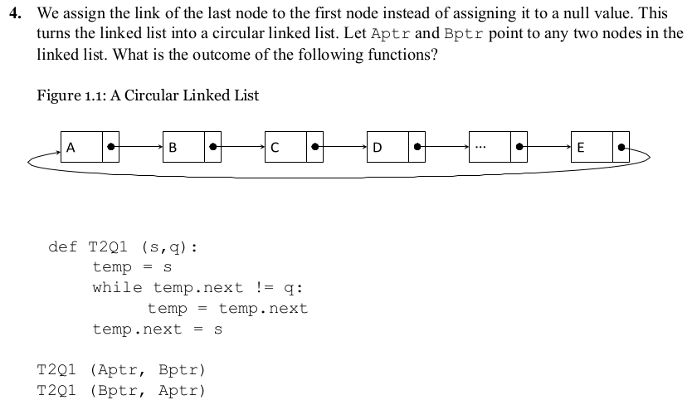
Question 4

Slide 24
Question 4
def T2Q1(s, q):
It starts from node s.
Traverses the list until it finds the node that comes BEFORE node q.
Updates the next pointer of this node to point back to s.

Slide 25
Question 4
def T2Q1(s, q):
It starts from node s.
Traverses the list until it finds the node that comes BEFORE node q.
Updates the next pointer of this node to point back to s.
Assume Aptr points to B and Bptr points to D:

Slide 26
Question 4
def T2Q1(s, q):
It starts from node s.
Traverses the list until it finds the node that comes BEFORE node q.
Updates the next pointer of this node to point back to s.
Assume Aptr points to B and Bptr points to D:
T2Q1(Aptr, Bptr):
Start at B (s = Aptr = B)
Traverse until we find the node before D (which is C)
Make C point back to B
Result B->C->B becomes one circle

Slide 27
Question 4
def T2Q1(s, q):
It starts from node s.
Traverses the list until it finds the node that comes BEFORE node q.
Updates the next pointer of this node to point back to s.
One circular list starts at Aptr and includes nodes up to (and including) the node BEFORE Bptr. This means B->C->B forms the first circle.
Another circular list starts at Bptr and includes nodes up to (and including) the node BEFORE Aptr. This means D->E->A->D forms the second circle.

Slide 28


Slides and Source-code
Slides
Source code

